Slide 1
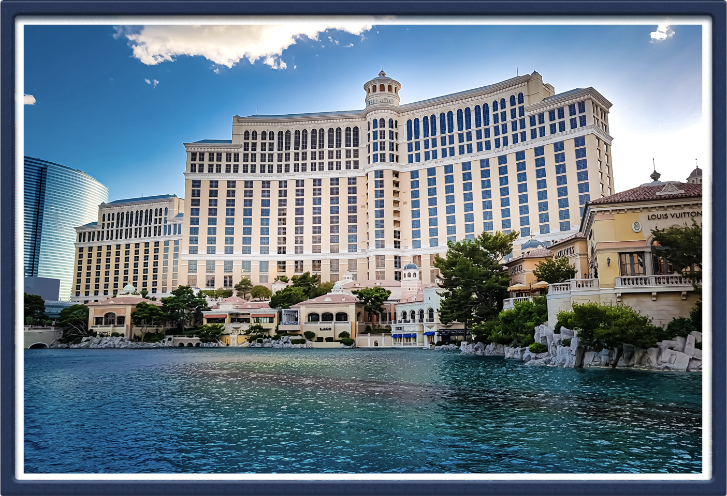
Hotel Rating Classification (DS-P-147)
Mentored by: Karthik Muskula, Dhanyapriya Somasundaram

Slide 2
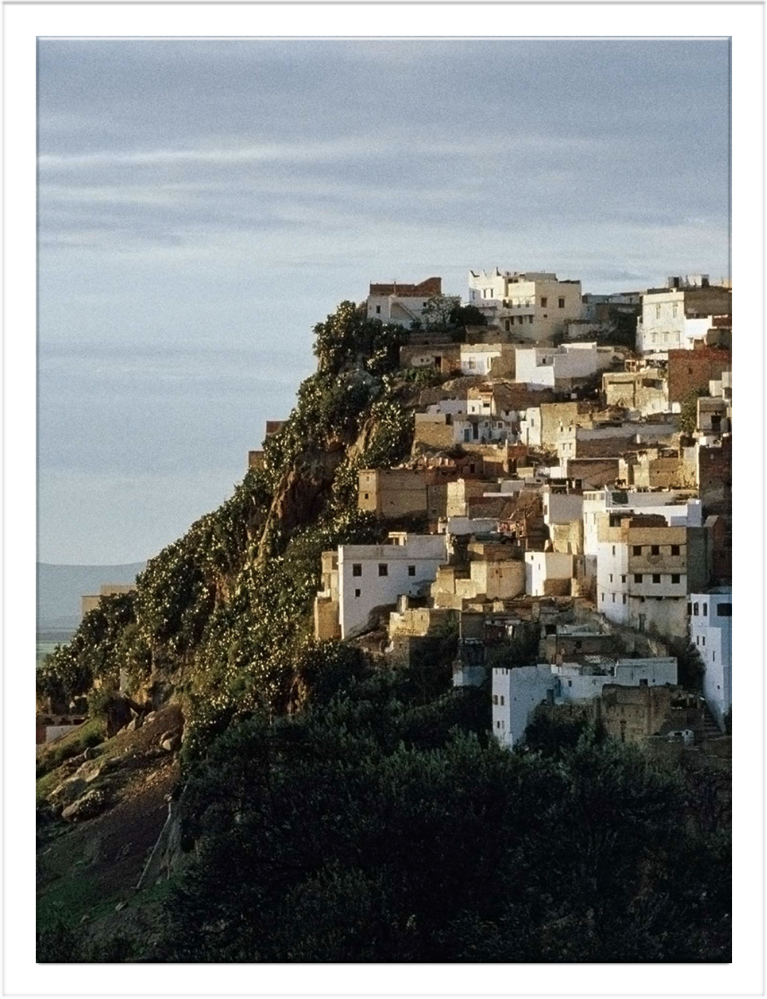
Group 4 Members
1. Urvi
2. Rajkumar
3. Jyoti
4. Nikshep
5. Vishakha
6. Rakesh
7. Payod

Slide 3

Business Objective
This is a sample dataset which consists of 20,491 reviews and ratings for different hotels.
Our goal is to examine how travelers are communicating their positive and negative experiences in online platforms for staying in a specific hotel .
Major objective is what are the attributes that travelers are considering while selecting a hotel.
With this manager can understand which elements of their hotel influence more in forming a positive review or improves hotel brand image.

Slide 4
Project Workflow
Text Preprocessing
EDA
Sentiment Analysis
Data Preparation
Model Building
Model Testing
Model Evaluation
Deployment
Data Understanding

Slide 5
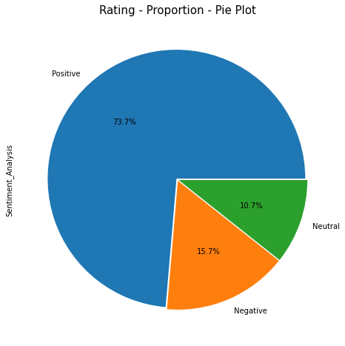
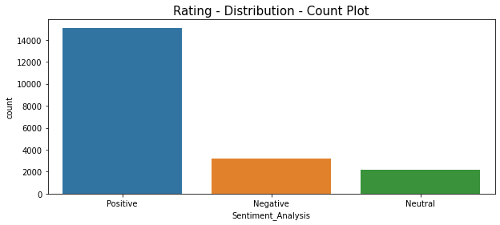
Rating Distribution
Ratings
Positive (4/5) – 15093
Neutral (3) - 2184
Negative (1/2)- 3214
Ratings are not in the same proportion.
It shows Class Imbalance.

Slide 6
Text Preprocessing/Cleaning
Converting all text into lower case
Removing non-alpha characters
Removing all the punctuations in reviews
Removing escape sequence/white space characters
Removing text between square brackets
Removing URLs
Removing stop words
Lemmatization
Words like ‘arrived and ‘talking’ are converted to ‘arrive’ and ‘talk’
They are converted to their base/root/stem words

Slide 7
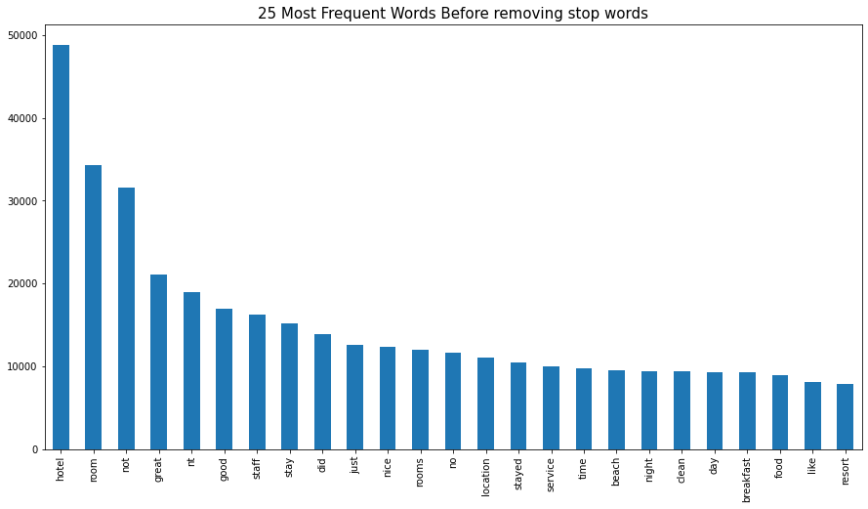
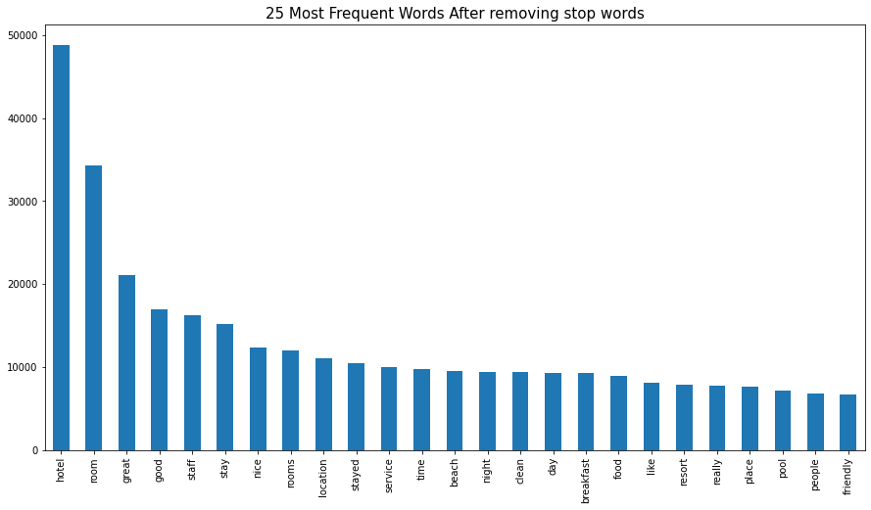
Stop Words
Words removed:
not, nt, did, no, just

Slide 8
Sentiment Analysis
Methods Used :
TextBlob
Vader Lexicon
Opinion Lexicon

Slide 9
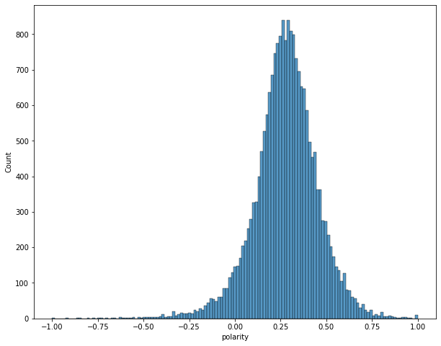
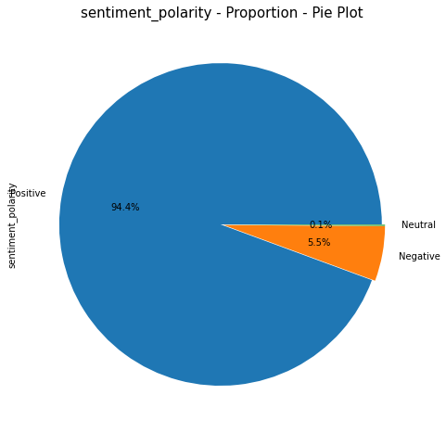
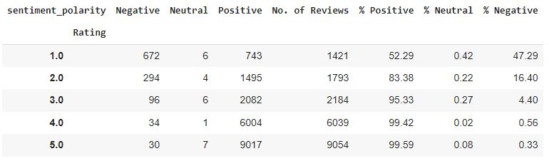
TextBlob

Slide 10
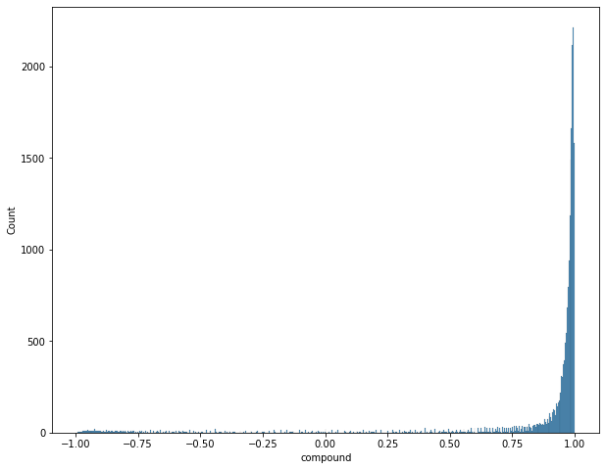
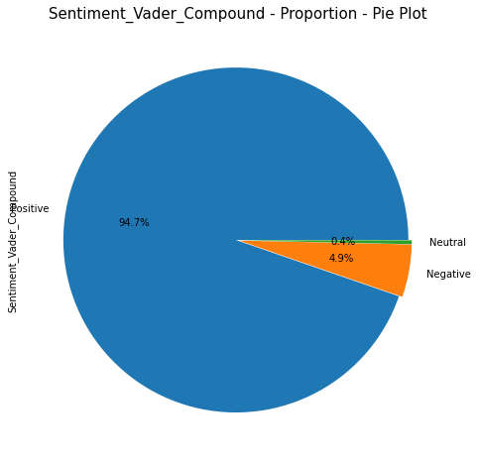
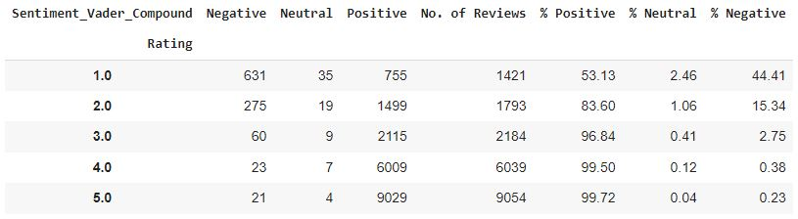
Vader-Lexicon

Slide 11
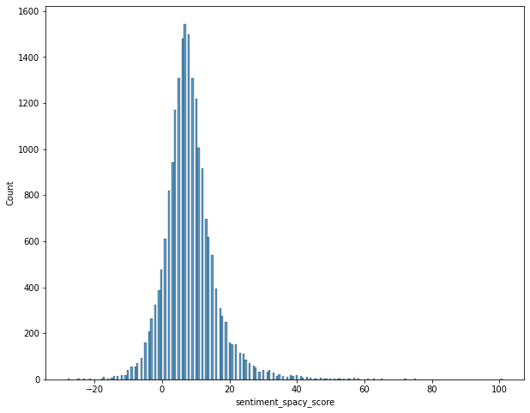
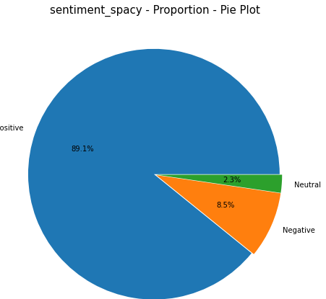
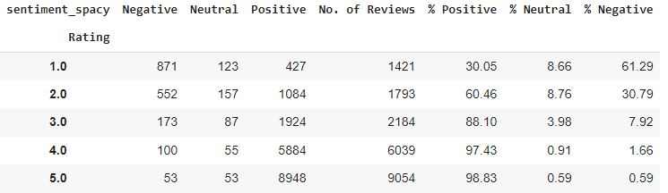
Opinion-Lexicon

Slide 12
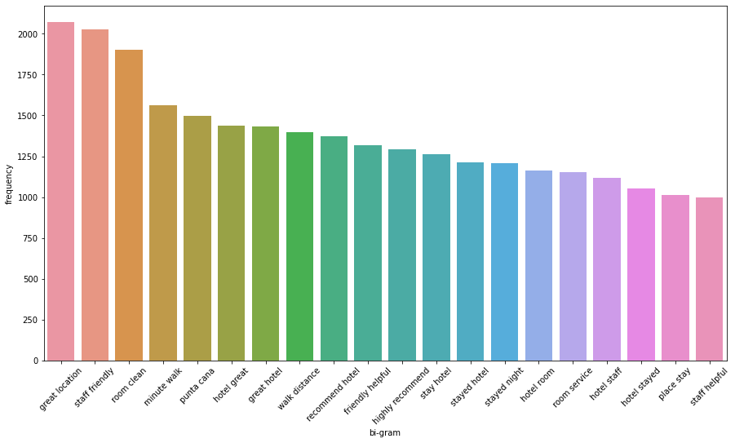
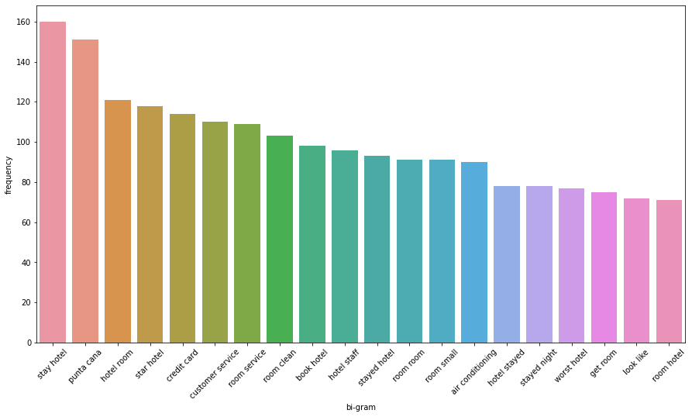
Bi-gram for positive words
Bi-gram for Negative words

Slide 13
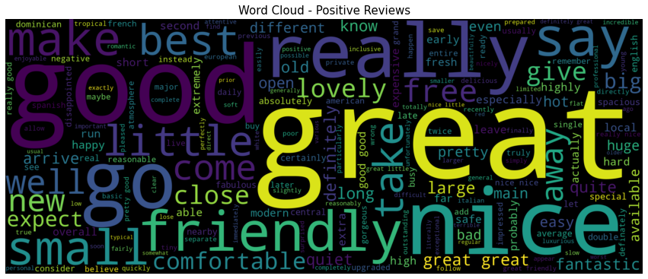
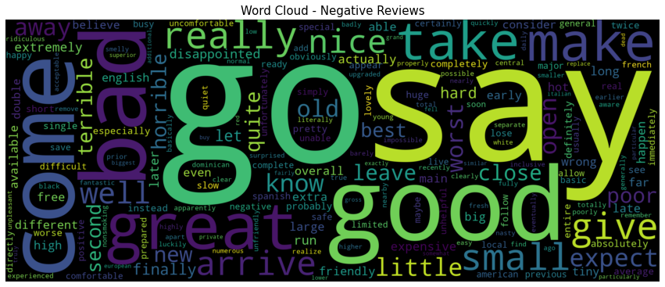
Word Cloud for Positive words
Word Cloud for Negative words

Slide 14
Most Positive(Best) Review(18917)
ocean blue excellent resort, boyfriend mid-20__Ç_é_ stayed ocean blue 6 days week june, awesome time relaxation beach ocean fruity frosty drinks, booked trip left read ocean blue reviews faithfully, little concerned negative reviews figured we__Ç_éö, think value ocean blue excellent booked hotel apple flight separately usa3000 ocean blue 57 day, reading reviews main complaints time food friendliness staff, travelers generally pretty happy hotel/grounds pools/beach rooms drinks, thing like note future ocean blue-goers all-inclusive travelers general all-inclusive resorts generally masses, tropical locale pretty inexpensive generally newer clean food drinks you__Ç_éö basic tgi friday__Ç_é_/outback/olive garden/etc, decent food price somewhat mass-produced, you__Ç_éÈe paying night hotel beach food alcohol activities you__Ç_éö paying nice meal high-end restaurant, saying goes pay not expect morton__Ç_é_ steakhouse meals not paying, advice i__Ç_é_x0096_ sure you__Ç_éêl enjoy review__Ç br/ flew usa3000 punta cana monday morning fairly uneventful pc airport pretty unique, thing not believe luggage people taking beach vacation, agghhh, took bags easy past bag vultures apple rep pointed bus, took hour ocean blue 3 quick hotel stops liked chance hotels, arrival able check early noon mentioned emailed request upper-level pool-view room desk rep. happily accommodated apple villa 5, smile ask check-in rep__Ç_é_ day right away not sure difference pleasant, walked bags room gave mini-tour, lobby resort grounds pools, looked wonderful clean definitely kept, no evidence construction lobby, arrived room just like pictures pretty basic beer soda water fridge beach towels bed air lights bright brought lightbulbs recommended did not need think ta pretty followed advice rooms lit, left maid 1 2 day given requested amounts beer water i__Ç_éö written post-it, room safe boyfriend left ipod clock dresser times money locked suitcases just case, did not use safe, problem shower pressure hot water showered 7:30pm night, mentioned rooms aging having read ta noticed things not notice not big deal agree look nice, think scuffs walls people lugging huge pieces luggage room, served purpose great view, thing note power goes times day reset air conditioner card clocks usually afternoon, little musty expected tropical climate, change thing room fluffier towels, love fluffy hotel towels pools great, clean, usually went 6pm evening dip warm feel nice time, preferred quieter blue pool, yellow pool fun going activity-oriented did participate cocktail making competition fun, noticed lots shaded chairs pools went breakfast 9am wonderful, shaded spot sit sun day, low season lots chairs shaded spots day, seaweed expected water floating said no seaweed pc pdc mexico, fine sand not hot, walked 2 miles way hotel beach definitely cleanest seaweed-wise, water refreshing, beach vendors huts bug bargained little rum shirts did not want waste time, i__Ç_é_x0096_ not big bargaining frankly little annoyed, trinkets pretty dollar store items offer like 30, beach bar blast, carlos omar awesome make sure know care smile fun meeting people having drinks afternoon, plenty top-shelf liquor just ask, favorite drinks blue hawaiian malibu absolut lemonade miami vice ask blended, hotel/grounds read, beautiful tropical, loved layout, wanderings went resorts ocean blue definitely nicest looking definitely best pools saw, did not like hotels__Ç layouts, ocean blue just villas pools middle restaurants/lobby beach perfect, used shuttle walk lobby beach 5-7 minutes much-needed continuous eating drinking restaurants/food breakfast main buffet enjoyed morning, omelet line moves quickly yummy fresh squeezed juice not miss treats, breakfast sweet breads bacon good, didn__Ç_é_ really try stuff buffet line middle grilled pineapple banana tasty, mimosa bar nice, lunch twice beach buffet basic food really liked paella it__Ç_é_ good quick lunch eat beach, enjoyed main buffet really excellent pizza mini-sandwiches rolls meat carving station tried little pasta/rice dishes tasty, day lunch dish called no joke boy__Ç, looked like burrito sauce, no idea knows enlighten, took picture little sign saying thought funny, not big fan dominican desserts general kind plain tasting strong sweet tooth, mike__Ç_é_ coffee excellent frozen coffee drinks wonderful, did not really like desserts macaroons cornflake/sugar mounds mike__Ç_é_, cute atmosphere, tried 5 free la carte__Ç_é_, caribbean grill beach buffet day favorite filet sooo good fried plantains pork cheese, dominican 2nd good beef garlic shrimp service especially outstanding, italian 3rd good chicken loved little antipasto bar, compare olive garden, mexican good pretty basic don pablo__Ç_é_ style nacho bar ok. american interesting experience think friday__Ç_é_ similar menu online just use don__Ç_é_ exactly make food says, burger__Ç, supposed fried jalapeno cheese spicy mayo just 2 burgers bun melted nacho cheese salsa, interesting just laughed, french fries good, wait restaurants wasn__Ç_é_ bad 2 waited italian mexican drink sports bar lady came table ready, larger groups did frustrated, workers not fast not expect disappointed, thing remember dining takes little longer, don__Ç_é_ bring meal 2 bites salad like it__Ç_é_ leisurely affair, service fine came wine water cleared plates away, loved atmosphere restaurant, nice ready eat__Ç night, buffet liked service better sand__Ç reason sat area waiters/waitresses probably led just popped disco looked kind neat casino small fine, lobby bar entertainment fantastic shows resort/cheesy entertainment, variety singing/dancing hit songs performers not wear clothing kids feel not appropriate wouldn__Ç_é_, did not bowling actually forgot, sports bar blast karaoke night, fun, overall went eat later 8:30pm-ish time just wanted chill did not really night activities, did not excursions content laying beach, did ride banana boat blast tipping great service right away tipped appreciation 1 breakfast lunch buffet 5 dinner bucks bartenders probably 70 total 2 6 days, work hard really appreciate, didn__Ç_é_ tip bartenders drink ready ordered, treat want treated not problem, remember omar carlos beach bar best love, did not timeshare salespeople maybe ocean blue took advice past travelers, forgot 3rd day wondered we__Ç_éö accosted sooner later did not happen__Çî__x0099_ay, went monday-saturday left pc 9pm sat, night resort did lot crowded saturday, resort not imagine resort packed service not good trying accommodate people staff no doubt gets overworked double number requests/complaints workers human just like stressed busy time work i__Ç_é_x0096_ sure, just smile don__Ç_é_ worked little things, overall price paid stay truly wonderful, agreed pay stay, beach great lounging nice breeze ocean beautiful blue warm room nice drinks cold food decent, just think normally pay 57 day hotel meals drinks__Ç yes definitely think ocean blue worth questions need information ocean blue just send email i__Ç_éêl happy help,

Slide 15
Most Negative (Worst) Review(6629)
worst hotel stayed booked holiday wary cheaper hotels resort just thought good deal, wrong were.room start place huge no directed room just arrived spent 30 minutes looking rooms, did tried stay positive basic dingy, soon getting annoyed, no hot water rooms problem know people door huge gap floor air conditioning vent big cracks floor tiles cracked tv didnt work not vitally important no light shower, restuarants main buffet restaurant awful, told alot restauruants dominican not air conditioned not happy fact restaurant not seperated eating area boiling appetites soon gone saw flys food supposed eat, getting food not fussy fact read peoples reviews saying poor restaurant just thought expecting, food really terrible, pregnanct time worried eating husband eat pasta sauce, cant comment overly restaurants actually ended paying extra hotels come, 3 nights catalonia, did try steakhouse ants crawling table soon appetites rest.staff know hotels staff unfriendly god staff awful, just giving dirty looks like doing favour, 2 choice reps miserable especially told wanted move.pool fountain middle pool mid morning morning brown murky bubbly film filth dead bugs, morning morning leaving man complaining hotel told girlfriend wouldnt come room reasons swim bar sick pool reported pool attendant shrugged said want, no wonder people bad stomachs attitude.beach unfortunately beach hotel loads seaweed not fault hotel.the overall probelms hotel based lack customer service lack air conditioning room importantly bar entertainement area restaurant.the final straw came woke middle night 2 huge cockroahes flying room got air conditioning crack door, husband managed squash invaded millions ants got broken balcony door.we demanded moved lack help reps ended phoning home parents sorting end, moving worth penny went iberostar bavaro tell fantastic recommend, activities programme fantastic 3 4 activities going time day 10am midnight, staff friendly welcoming phoning room check ok sending bottles rum fruit platters.the catalonia non existant day evening embarrassing, airport way home met couple catalonia 2 weeks woman huge boil type blisters friends cataloinia bitten head toe, tell husband bitten loads whilst lot streams fish birds water filthy stank, mozzies, moved wasnt bitten difference streams cleaned didnt attract mozzies couple told things stolen balconies complaints non stop, apparently choice said getting complaints summer going drop hotel brochure, spending lot money dominican dont ruin holiday booking catalonia booked change, wish did saved lot upset stress, didnt speak person liked catalonia

Slide 16
ACCURACY & F1 SCORE (Top 3 models out of 10 models trained)
When considered 5 Classes : Ratings 1 to 5
Logistic Regression
Training Accuracy : 80.08 Testing Accuracy : 44.05 Training F1 Score : 80.64 Testing F1 Score : 54.21
SVM
Training Accuracy : 96.27
Testing Accuracy : 44.06
Training F1 Score : 96.28
Testing F1 Score : 56.51
Neural Network
Training Accuracy : 91.08
Testing Accuracy : 41.18
Training F1 Score : 91.06
Testing F1 Score : 48.27
When considered 3 Classes : 0-Negative, 1-Neutral, 2-Positive
Logistic Regression
Training Accuracy : 90.47
Testing Accuracy : 71.7
Training F1 Score : 91.9
Testing F1 Score : 79.04
SVM
Training Accuracy : 97.36
Testing Accuracy : 72.55
Training F1 Score : 97.48
Testing F1 Score : 81.21
Neural Network
Training Accuracy : 96.6
Testing Accuracy : 72.74
Training F1 Score : 96.63
Testing F1 Score : 81.61

Slide 17
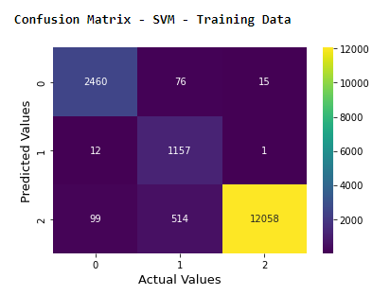
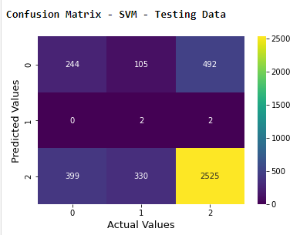
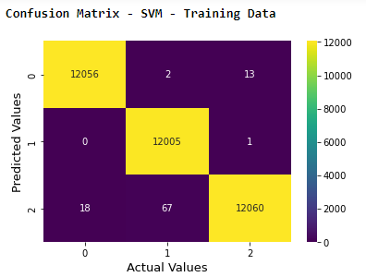
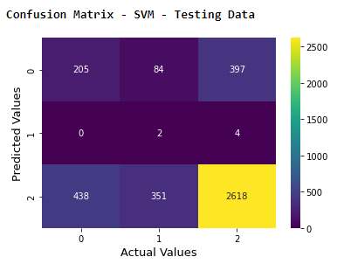
Final Model – SVM
Before SMOTE
Training Accuracy : 95.63
Training F1 Score : 95.95
Testing Accuracy : 67.60
Testing F1 Score : 70.66
Final Model – SVM
After SMOTE
Training Accuracy : 99.72
Training F1 Score : 99.72
Testing Accuracy : 68.92
Testing F1 Score : 72.89

Slide 18
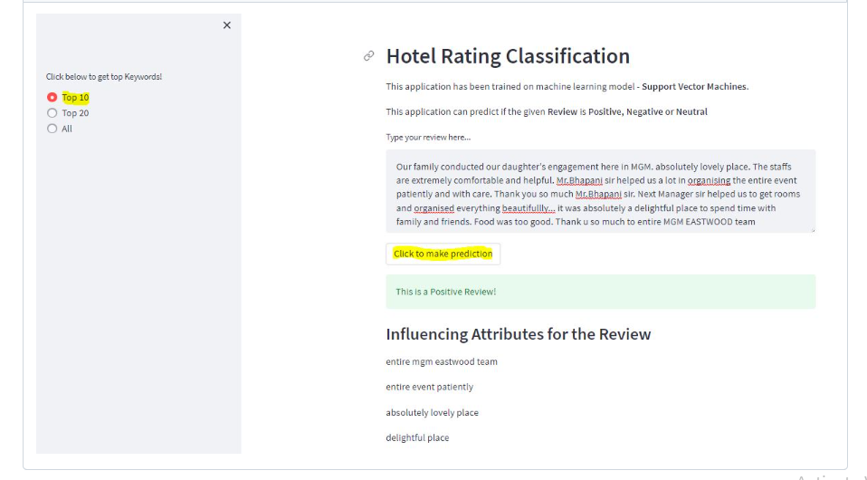
Deployment - Streamlit

Slide 19
Challenges Faced
Dealing with Imbalanced Dataset – Selecting right sampling technique
Selecting right python module for Keyword Extraction
Sentiment Analysis – Exploring various Methods
Deployment

Slide 20
Conclusion
This dataset consists of 20,491 reviews and ratings for different hotels
First of all, to observe the structure of the data, outliers and features that affect the target variable,
we used exploratory data analysis and data visualization techniques.
Then, we performed text preprocessing technique to clean the text data, remove stop words and lemmatize them.
To fix the class Imbalance, we did SMOTE analysis to oversample the data.
We built models to predict the given review is positive, negative or neutral. We trained our models with train set, tested the success of models with test set.
In this study, we made modelling with Logistic Regression, XG Boost, Random Forest, Decision Tree, KNN, Ada Boost, LG Boost , Naïve Bays, SVM and Neural Network.
After Analyzing Training and Testing accuracy we finalized SVM as our final Model by applying SMOTE.

Slide 21
Thank you !

